Slide 1
ETL Presentation
BY: Kevin Bader, Kendall Sisk, and Josh Heisler (Group 3)

Slide 2
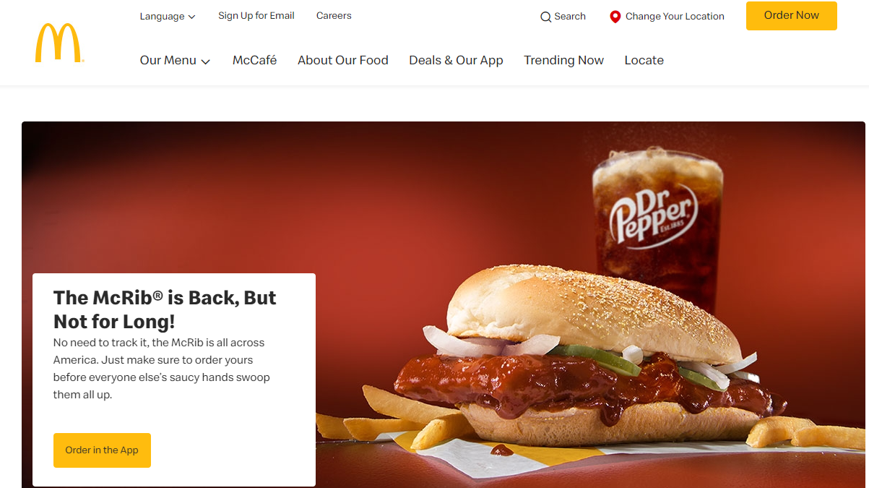
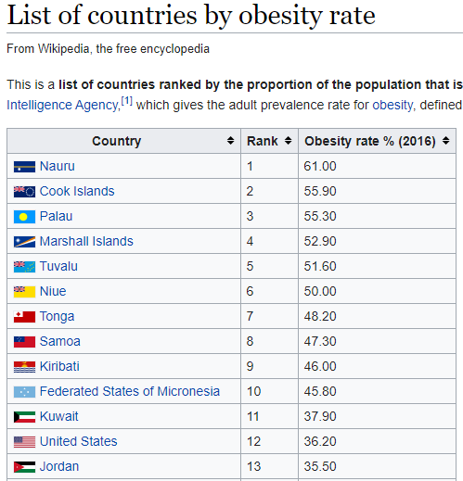
Initial Proposal
Find Interesting topic
Locate relevant data
Convert to usable form
Its Back!

Slide 3


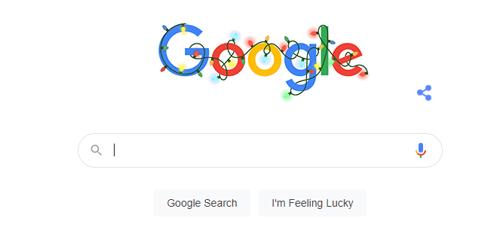
A Data Hunt
Searching in Kaggle
Looking via google
Using .GOV sources

Slide 4
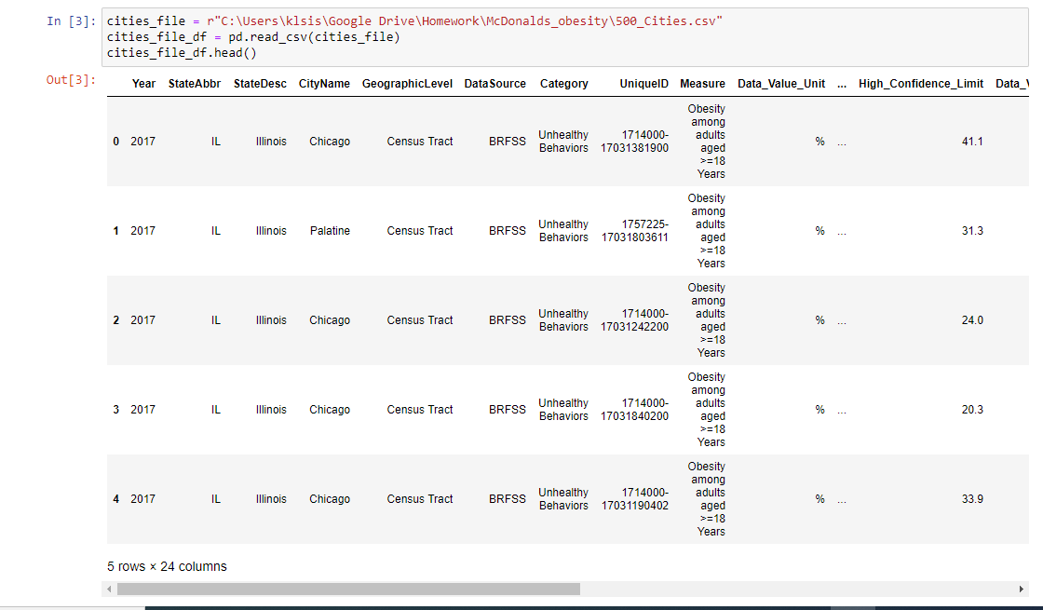
Scrub That Data
Initial coding structure
Using previous examples
Group Work
Before Clean

Slide 5
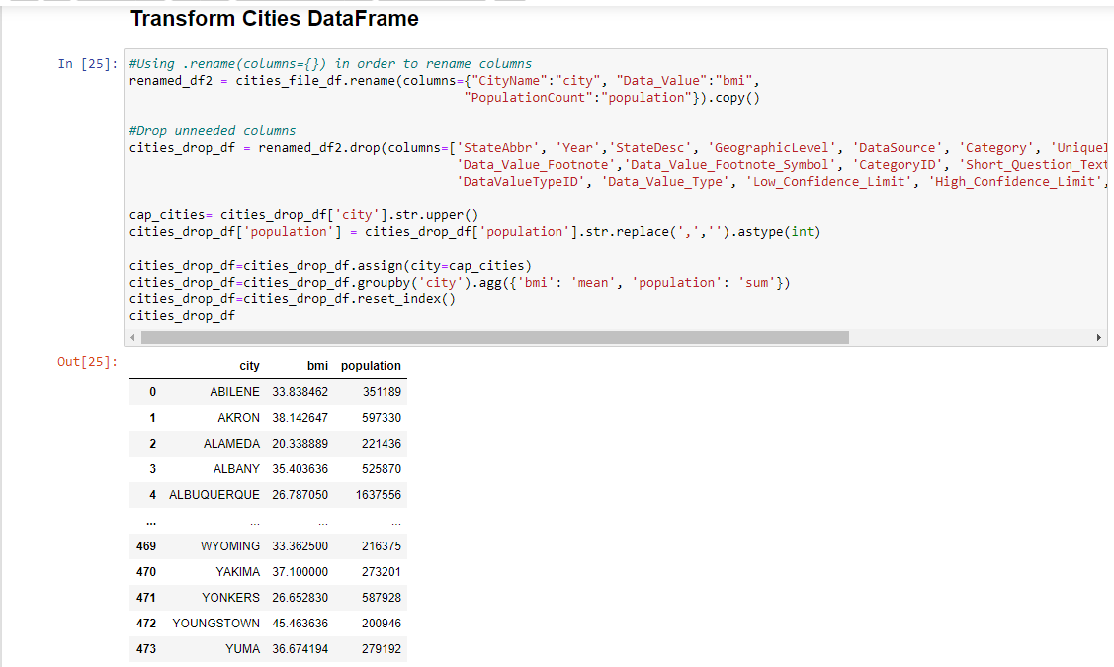
Formatting Causes Distress(Pandas)
Making sure all data was homogenous
Finding any and all bugs(must be squashed)
Making sure transfer to SQL was smooth(was not)
After Clean

Slide 6
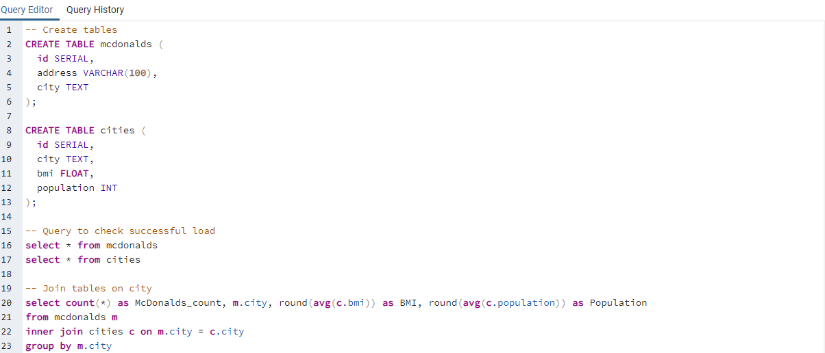
Formatting Causes Distress(SQL)
Cleaned Code
Formating the tables with proper columns
Carry over data from pandas
Linking the tables

Slide 7
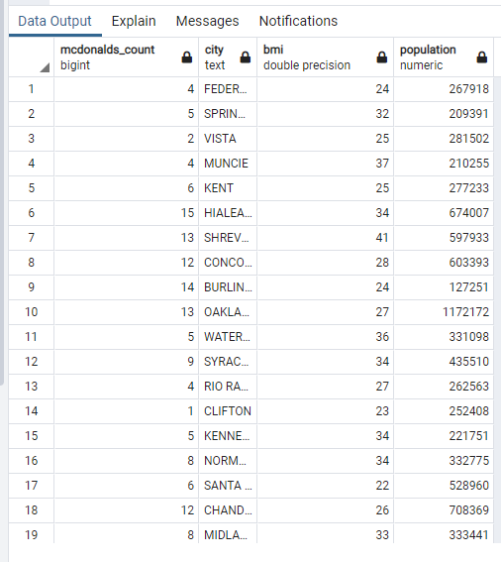
Pulling it Together
Followed instructions for linking the two tables
Ended up with a combine table that shows needed information
Queries
Joined table

Slide 8
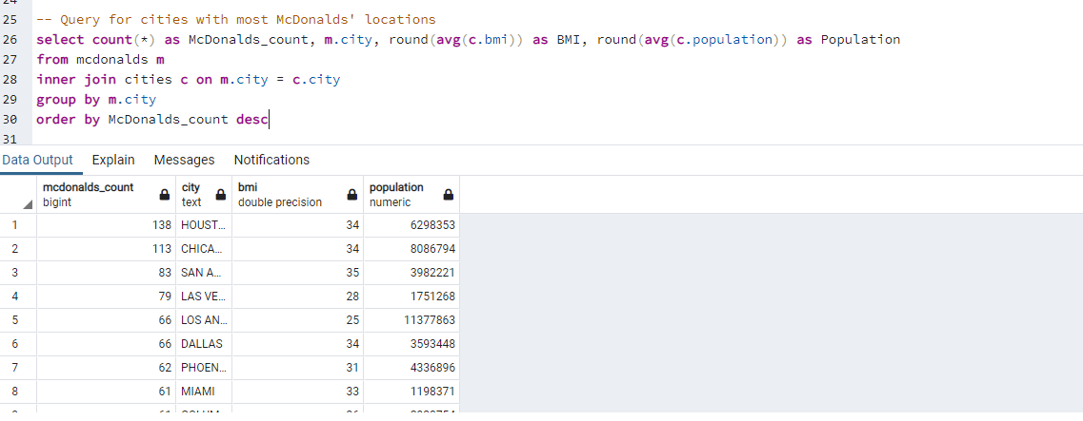
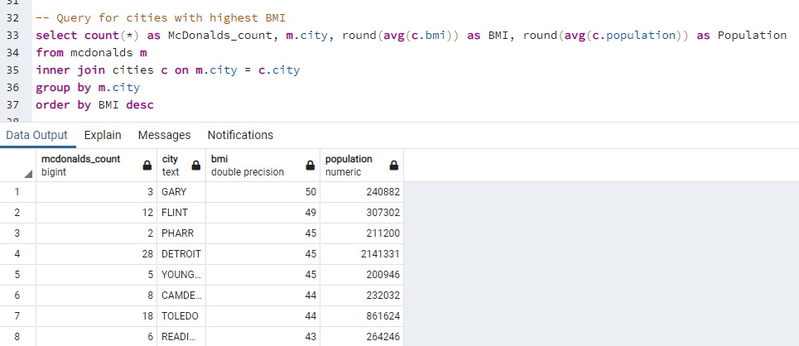
Queries in SQL

Slide 9


Final Reflections
Important to scrub properly
Linking the SQL and Pandas useful
Ended up with usable and successful database!

Slide 10
Resources
500 Cities: Obesity among adults aged >=18
https://chronicdata.cdc.gov/500-Cities-Places/500-Cities-Obesity-among-adults-aged-18-years/bjvu-3y7d
29006 Rows
21 Columns
McDonalds Locations
https://www.kaggle.com/ben1989/mcdonalds-locations?select=McDonalds.csv
13801 Rows
27 Columns
Thank you to David, Aaron, and, Steven for coding help!

